Slide 1



Swift Task - Professional Task Management System
Author: Abdul Rehman
Created with Pi

Slide 2
01
PROJECT OVERVIEW

Slide 3

What is Swift Task?
Swift Task is a professional, browser-based task management application that allows users to organize their work through a hierarchical structure of boards, folders, and tasks. It's designed as a single-page application (SPA) that works entirely in the browser without requiring any server setup.

Slide 4








Key Features
1
User Authentication System - Simple username-based login.
2
Hierarchical Organization - Boards → Folders → Tasks structure.
3
Task Management - Create, edit, delete, and track tasks.
4
Priority System - 4 priority levels (Low, Medium, High, Urgent).
5
Status Tracking - 3 status types (Pending, Active, Completed).
6
Real-time Countdown - Live countdown timers for task deadlines.
7
Edit Limits - Maximum 3 edits per task to prevent over-editing.
8
Search Functionality - Search across boards, folders, and tasks.
9
Responsive Design - Works on desktop, tablet, and mobile devices.
10
Data Persistence - Automatic saving to browser localStorage.

Slide 5

02
TECHNICAL ARCHITECTURE

Slide 6


Technology Stack
1
Frontend: HTML5, CSS3, JavaScript (ES6+).
2
UI Framework: Bootstrap 5.3.0.
3
Icons: Font Awesome 6.4.0.
4
Fonts: Google Fonts (Inter).
5
Storage: Browser localStorage.
6
No Backend Required - Pure client-side application.

Slide 7

03
USER INTERFACE DESIGN

Slide 8



UI Components
Login Screen
Dashboard Navigation
Search & Board Creation
• Glassmorphism Effect: Semi-transparent card with backdrop blur.
• Bootstrap Navbar: Clean, responsive navigation.
• Search Bar: Type-specific search (All, Boards, Folders, Tasks).
• Gradient Background: Professional blue gradient.
• User Dropdown: Profile and logout options.
• Board Creation: Quick add board functionality.
• Brand Identity: Swift Task logo and name.
• Responsive Layout: Adapts to screen size.
• Animated Elements: Smooth slide-up animation.
• Demo User Information: Shows available test accounts.
Board Display
Task Cards
• Collapsible Boards: Expand/collapse functionality.
• Priority Indicators: Color-coded left border.
• Folder Organization: Nested folder structure.
• Status Buttons: Interactive status management.
• Task Management: Individual task cards with actions.
• Countdown Timers: Real-time deadline tracking.
• Action Buttons: Edit, delete, status change.

Slide 9

04
CORE FUNCTIONALITY

Slide 10

User Authentication System
Static User Management
const STATIC_USERS = [ { username: 'Faraz Mehdi', id: 'user_1', joinDate: '2024-01-15' }, { username: 'Abdul Rehman', id: 'user_2', joinDate: '2024-02-20' }, { username: 'Ali Mehroz', id: 'user_3', joinDate: '2024-03-10' } ];

Slide 11

User Authentication System
Login Process
1
User enters username.
2
System validates against static user list.
3
Loads user-specific data from localStorage.
4
Switches to dashboard view.
5
Displays welcome notification.

Slide 12



Board Management System
1
Board Creation
2
Board Operations
• Validation: Prevents duplicate board names.
• Add Folders: Create organizational sub-categories.
• Auto-generation: Unique IDs using timestamp + random string.
• Delete Boards: Removes board and all contained data.
• Collapsible Interface: Expand/collapse for better organization.
• Metadata: Creation date tracking.
• Empty State: Shows helpful message when no boards exist.
• Statistics Display: Shows folder and task counts.

Slide 13


Folder Management System
Folder Structure
Folder Operations
• Nested Organization: Folders within boards.
• Add Tasks: Create tasks within specific folders.
• Task Containers: Folders hold individual tasks.
• Delete Folders: Removes folder and all tasks.
• Metadata Tracking: Creation dates and task counts.
• Auto-expand: Opens folder when new task is added.
• Validation: Prevents duplicate folder names within same board.
• Empty State: Shows helpful message when no tasks exist.

Slide 14



Task Management System
1
Task Creation Process
2
Task Properties
3
Task Operations
• Form Validation: Ensures all required fields are filled.
• Title: Task name (required).
• Edit Tasks: Modify task details (limited to 3 edits).
• Priority: Low, Medium, High, Urgent (color-coded).
• Date Validation: Prevents past due dates.
• Delete Tasks: Remove tasks permanently.
• Status: Pending, Active, Completed (interactive buttons).
• Time Validation: Ensures start time is before due time.
• Status Changes: Update task progress.
• Dates: Start and due dates with time.
• Duplicate Prevention: Checks for existing task names.
• Countdown Display: Real-time deadline tracking.
• Description: Optional detailed description.
• Auto-assignment: Sets default status to "Pending".
• Edit Tracking: Count of edits and last edit date.

Slide 15
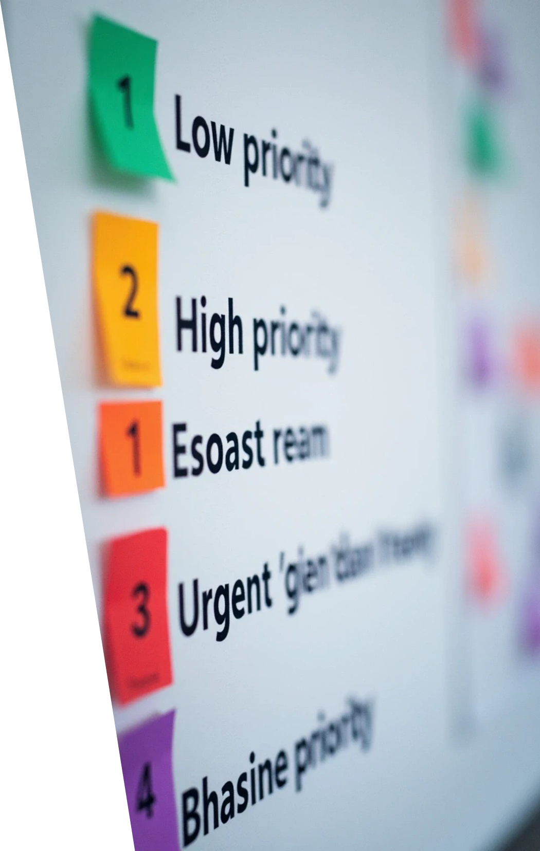


Priority System
Priority Levels
• Low Priority (Green): Non-urgent tasks.
• Medium Priority (Orange): Standard tasks.
• High Priority (Red): Important tasks.
• Urgent Priority (Purple): Critical tasks.
Visual Indicators
• Color-coded Borders: Left border indicates priority.
• Priority Badges: Styled priority labels.
• Sorting: Tasks sorted by priority (highest first).

Slide 16



Status Management
1
Status Types
2
Status Features
• Pending: New tasks awaiting action.
• Interactive Buttons: Click to change status.
• Active: Tasks currently being worked on.
• Visual Feedback: Active status highlighted.
• Completed: Finished tasks.
• Progress Tracking: Monitor task completion.

Slide 17
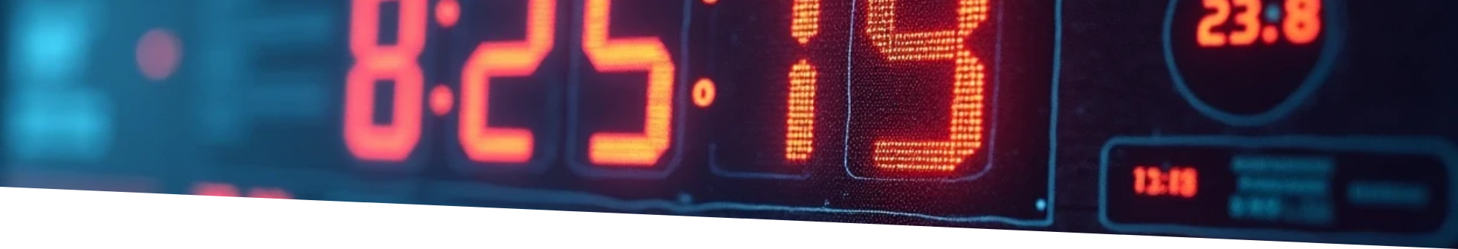

Countdown System
Real-time Updates
Live Countdown
Multiple Formats
Overdue Detection
Urgency Indicators
Updates every second.
Days, hours, minutes, seconds.
Shows overdue time when past deadline.
Visual warnings for approaching deadlines.

Slide 18
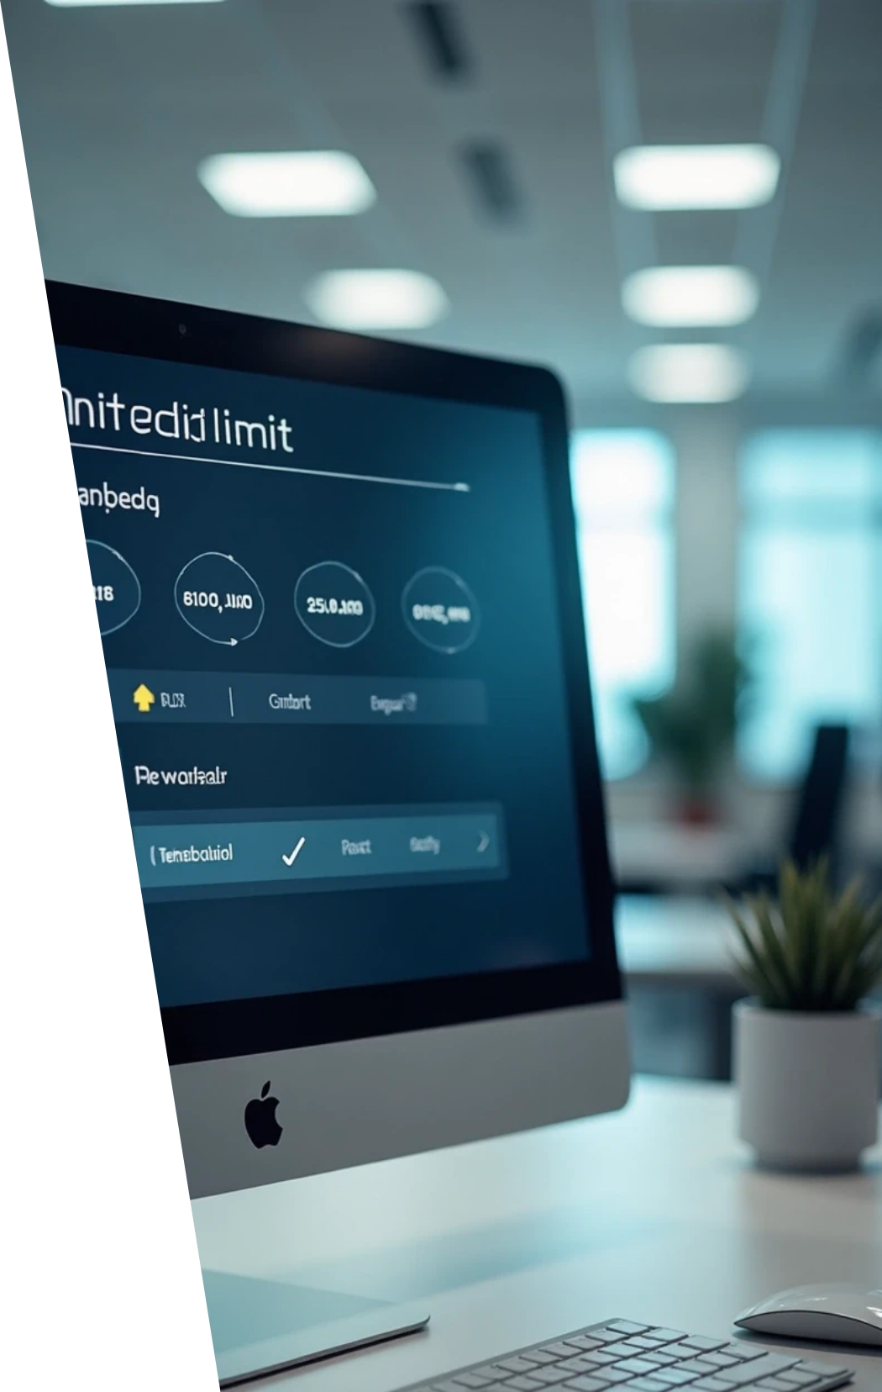
Edit Limit System
Edit Restrictions
• Maximum Edits: 3 edits per task.
• Edit Counter: Tracks number of edits made.
• Visual Feedback: Shows remaining edits.
• Disabled State: Edit button disabled after limit reached.
Edit Tracking
• Edit Count: Incremented with each save.
• Last Edited: Timestamp of last modification.
• Validation: Prevents saving when limit reached.

Slide 19

05
SEARCH FUNCTIONALITY

Slide 20
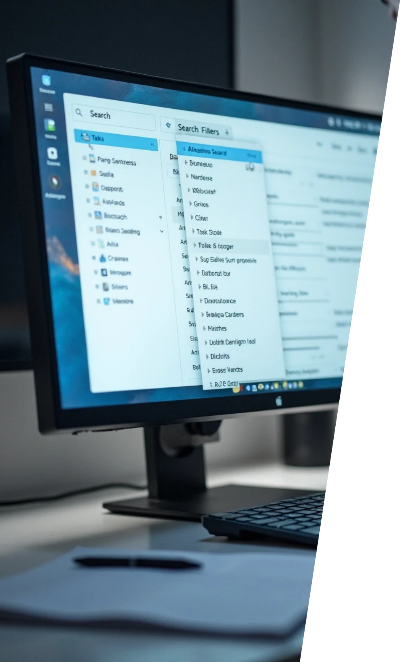

Search Types
All
Boards
Searches across boards, folders, and tasks.
Searches only board names.
Folders
Tasks
Searches only folder names.
Searches task titles, descriptions, priorities, and statuses.

Slide 21
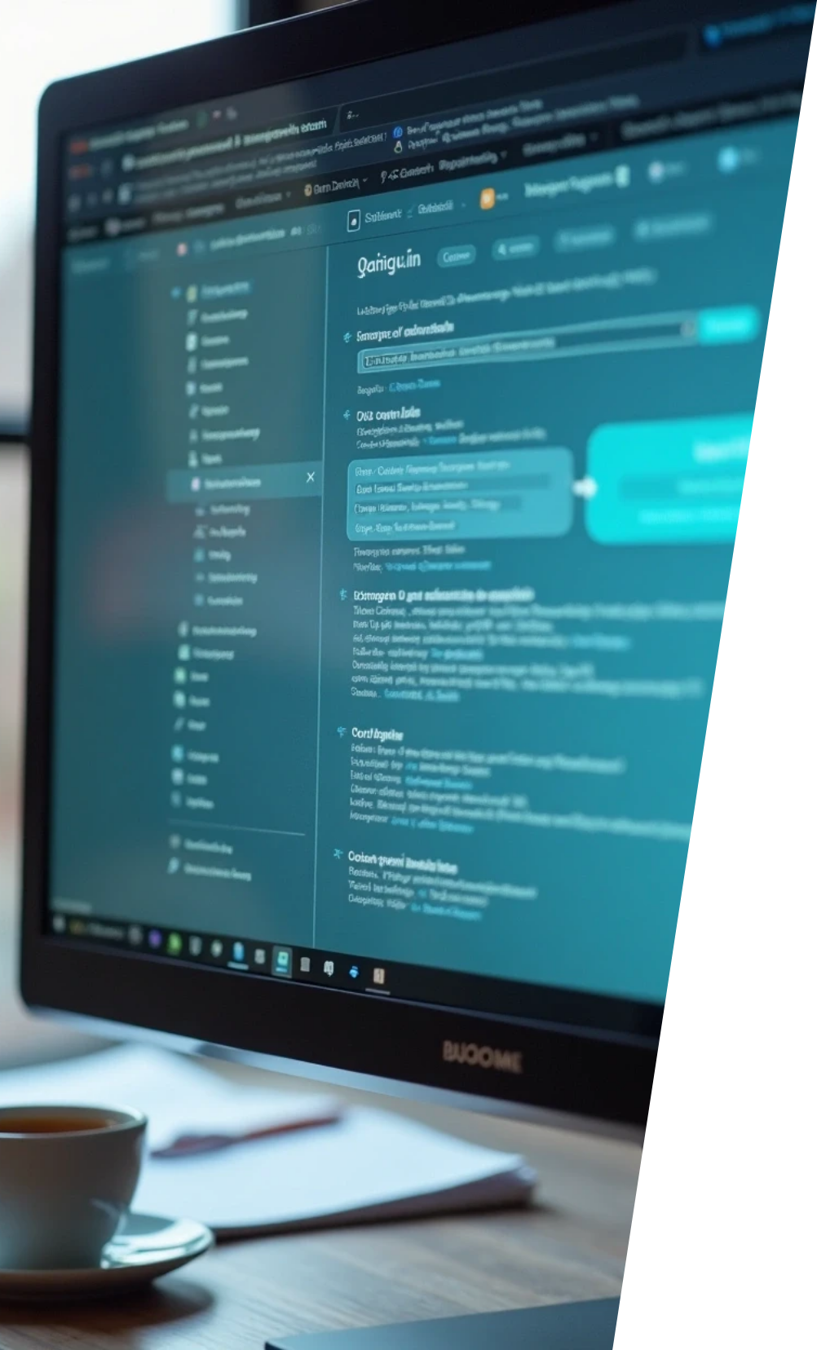


Search Features
1
Real-time Search
2
Highlighting
Results update as you type.
Search terms highlighted in results.
3
Auto-expand
4
Clear Search
Relevant boards/folders automatically open.
Easy way to reset search and view all items.

Slide 22

06
DATA PERSISTENCE

Slide 23


Data Operations
Save Data
Load Data
saveData(userId, data).
loadData(userId).
Clear Data
Error Recovery
Automatic on logout.
Fallback to empty data structure.

Slide 24

07
RESPONSIVE DESIGN

Slide 25


RESPONSIVE DESIGN
Breakpoint Strategy
Responsive Features
Mobile Optimizations
• Desktop: 1024px and above.
• Flexible Layouts: Bootstrap grid system.
• Touch Targets: Minimum 44px for buttons.
• Tablet: 768px to 1023px.
• Touch-friendly: Minimum 44px touch targets.
• Simplified Actions: Stacked buttons on small screens.
• Mobile: 576px to 767px.
• Small Mobile: 375px to 575px.
• Readable Text: Appropriate font sizes for each screen.
• Optimized Modals: Full-width modals on mobile.
• Ultra Small: 320px to 374px.
• Optimized Navigation: Collapsible menus and simplified layouts.
• Improved Spacing: Better padding and margins.

Slide 26

08
USER EXPERIENCE FEATURES

Slide 27



USER EXPERIENCE FEATURES
Notifications System
Animations and Transitions
• Success Notifications: Green notifications for successful actions.
• Smooth Transitions: CSS transitions for all interactions.
• Error Notifications: Red notifications for errors.
• Loading States: Visual feedback during operations.
• Info Notifications: Blue notifications for information.
• Hover Effects: Interactive elements respond to mouse hover.
• Auto-dismiss: Notifications disappear after 3 seconds.
• Slide Animations: Smooth expand/collapse animations.
• Non-intrusive: Positioned in top-right corner.
Accessibility Features
User Profile System
• Keyboard Navigation: All functions accessible via keyboard.
• Statistics Display: Shows total, completed, and pending tasks.
• Screen Reader Support: Proper ARIA labels and semantic HTML.
• User Information: Displays username and join date.
• High Contrast: Clear color contrast for readability.
• Visual Profile: Avatar and user details.
• Focus Indicators: Visible focus states for keyboard users.
• Modal Interface: Clean profile display.

Slide 28
09
TESTING AND QUALITY ASSURANCE

Slide 29

TESTING AND QUALITY ASSURANCE
Browser Compatibility
User Testing Scenarios
Error Handling
• Modern Browsers: Chrome, Firefox, Safari, Edge.
• New User Flow: First-time user experience.
• Graceful Degradation: App works even with errors.
• Mobile Browsers: iOS Safari, Chrome Mobile.
• Power User Flow: Advanced feature usage.
• User Feedback: Clear error messages.
• Data Recovery: Automatic data backup.
• Responsive Testing: All screen sizes tested.
• Mobile Usage: Touch interface testing.
• Data Management: Large dataset handling.
• Fallback Mechanisms: Alternative functionality when needed.
• Feature Detection: Graceful degradation for older browsers.

Slide 30

10
DEPLOYMENT AND DISTRIBUTION

Slide 31

DEPLOYMENT AND DISTRIBUTION
Distribution Methods
Installation Instructions
Maintenance
• Direct File Sharing: Share HTML file directly.
• Download Files: Get all project files.
• Regular Updates: Keep libraries updated.
• Open index.html: Launch in any modern browser.
• Web Hosting: Deploy to web server.
• Browser Compatibility: Test with new browser versions.
• GitHub Pages: Free hosting option.
• Start Using: No additional setup required.
• User Feedback: Incorporate user suggestions.
• Local Network: Share on local network.
• Data Persistence: Automatic local storage.
• Performance Monitoring: Track application performance.

Slide 32
11
CONCLUSION

Slide 33
11
CONCLUSION

Slide 34

Project Summary
Swift Task is a comprehensive, professional-grade task management application that demonstrates modern web development practices. It provides a complete solution for personal and small team task organization with a focus on user experience, performance, and reliability.

Slide 35

Key Achievements
1
Complete Functionality: All core task management features implemented.
2
Professional Design: Modern, responsive interface.
3
Robust Architecture: Well-structured, maintainable code.
4
User-friendly: Intuitive navigation and clear feedback.
5
Cross-platform: Works on all modern devices and browsers.
6
No Dependencies: Self-contained application.

Slide 36



Technical Excellence
Clean Code: Well-documented, organized JavaScript.
Modern CSS: Advanced styling with responsive design.
Semantic HTML: Proper structure and accessibility.
Performance Optimized: Efficient rendering and data handling.
Error Resilient: Graceful error handling and recovery.
This application serves as an excellent example of modern web development, demonstrating best practices in frontend development, user interface design, and application architecture.

Slide 37
Website Link: rebrand.ly/taskmanager

Slide 38
Thank You

